Slide 1



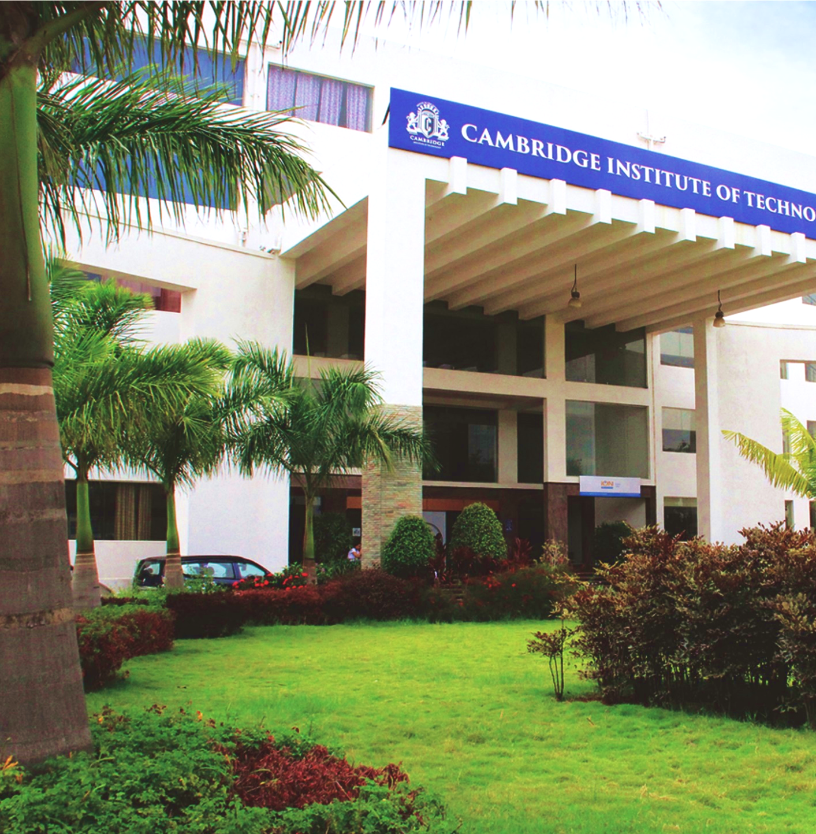
Department of Information Science & Engineering
Project Review – 1
Title : DermaLens:
A fairness-Aware, Explainable smartphone Application for Early Skin Cancer Risk Assessment
Batch No. - 02 .
V Dhanush (1CD23IS181) Sanjana T G (1CD23IS145) Vasudha (1CD23IS186)
Under the guidance of:
Dr. Priyanka Desai Prof , ISE department.
www.cambridge.edu.in

Slide 2

ABSTRACT
Abstract
Skin cancer, one of the most prevalent cancers worldwide, demands early and accurate detection for improved patient outcomes. Existing AI-based diagnostic tools suffer from racial bias - performing poorly on darker skin tones due to skewed training datasets - and lack transparency in their decision-making. DermaLens addresses these gaps by proposing a fairness-aware, explainable skin lesion classification system for mobile deployment.
The system is built on FairDermNet, a lightweight deep learning architecture combining MobileNetV3-Large with a FairnessAttentionModule (FAM) and Generalised Mean Pooling (GeM), trained to classify dermoscopic and smartphone images into 9 clinically relevant categories: MEL, BCC, SCC, AK, BOD, NV, BKL, DF, and VASC. Training integrates a composite fairness loss that penalises performance disparity across Fitzpatrick skin-tone groups I–VI, evaluated on the held-out DDI Stanford dataset. Grad-CAM and SHAP-based visual explanations are generated per prediction to support clinical interpretability. The final model is exported as a TFLite INT8 quantised model and integrated into a cross-platform Flutter application, enabling accessible, on-device inference without specialist hardware.
DermaLens demonstrates that accuracy, fairness, and explainability can be jointly optimised in a resource-efficient architecture, contributing a reproducible pipeline for equitable AI-assisted dermatology.
Department of information Science and Engineering
www.cambridge.edu.in

Slide 3
INTRODUCTION
Skin cancer accounts for a significant proportion of cancer diagnoses globally, with early detection being the single most critical factor in improving survival rates. Dermatologists rely on visual examination of skin lesions, a process that is time-intensive, specialist-dependent, and largely inaccessible to rural or resource-limited populations. The rapid advancement of deep learning has opened the door to automated skin lesion analysis - yet most existing models are trained predominantly on dermoscopic images of lighter skin tones, leading to well-documented performance disparities across diverse patient demographics.
Beyond accuracy, clinical adoption of AI diagnostic tools demands transparency. A model that outputs a diagnosis label without justification offers little value to a practitioner who must explain and defend every clinical decision.
DermaLens is proposed as a fairness-aware, explainable skin cancer detection system designed to address both shortcomings. By combining a lightweight neural architecture with skin-tone-conditioned fairness regularisation, multi-dataset training, and Grad-CAM-based visual explanations, DermaLens aims to deliver equitable and interpretable 9-class lesion classification on a smartphone - making reliable preliminary diagnosis accessible to anyone, anywhere.
Department of information Science and Engineering
www.cambridge.edu.in

Slide 4
PROBLEM STATEMENT
Despite significant advances in AI-assisted medical imaging, automated skin cancer detection systems remain hindered by three fundamental problems.
Demographic Bias: Publicly available dermoscopy datasets such as HAM10000 and ISIC 2019 are heavily skewed toward Fitzpatrick skin-tone groups I–III (lighter skin), causing trained models to exhibit significantly lower sensitivity and specificity on patients with darker skin tones (Fitzpatrick IV–VI) - the very population least likely to have access to specialist dermatological care.
Lack of Explainability: Most deployed classification models function as black boxes, providing a diagnostic label without any visual or feature-level justification. This opacity prevents clinical adoption, as practitioners cannot verify, trust, or act on predictions without understanding their basis.
Limited Accessibility: High-quality skin lesion analysis currently requires expensive dermatoscopy hardware and trained specialists, creating a significant barrier in primary care, rural, and low-income settings where early screening is most needed.
Collectively, these gaps result in an AI diagnostic landscape that is accurate for a narrow demographic, uninterpretable to clinicians, and inaccessible to the broader population. DermaLens is proposed to directly address all three - building a system that is fair across skin tones, explainable in its reasoning, and deployable on an ordinary smartphone.
Department of information Science and Engineering
www.cambridge.edu.in

Slide 5
Objectives
To classify skin lesions into 9 categories (MEL, BCC, SCC, AK, BOD, NV, BKL, DF, VASC) using a lightweight deep learning model trained on multi-source dermoscopic and smartphone image datasets.
To incorporate skin-tone fairness regularisation ensuring equitable model performance across Fitzpatrick skin-tone groups I–VI.
To generate per-prediction visual explanations using Grad-CAM and SHAP, improving model interpretability and clinical transparency.
To export the trained model as a TFLite INT8 quantised format for efficient on-device inference within a cross-platform Flutter mobile application.
To evaluate model performance and fairness metrics on the held-out DDI Stanford dataset, benchmarking bias reduction across diverse skin-tone groups.
Department of information Science and Engineering
www.cambridge.edu.in

Slide 6
PROPOSED SOLUTION
Design FairDermNet - a custom architecture built on MobileNetV3-Large, extended with a FairnessAttentionModule (FAM) and Generalised Mean Pooling (GeM) for skin-tone-aware feature extraction.
Train on a combined dataset of ~37,000 images (HAM10000 + ISIC 2019 + PAD-UFES-20) spanning dermoscopic and smartphone image sources across 9 lesion classes.
Apply a composite fairness loss (α=1.0, β=0.15, γ=0.25) during training to penalise performance disparity across Fitzpatrick skin-tone groups I–VI.
Integrate Grad-CAM and SHAP explainability modules to generate visual heatmaps highlighting the lesion regions driving each prediction.
Export the best checkpoint as a TFLite INT8 quantised model for lightweight, on-device inference without cloud dependency.
Deploy via a Flutter mobile application that accepts a smartphone image, runs inference locally, and displays the predicted class, confidence score, and Grad-CAM overlay.
Conduct a fairness audit on the held-out DDI Stanford dataset (656 images) to evaluate and report equalized odds across skin-tone codes 12 / 34 / 56.
Department of information Science and Engineering
www.cambridge.edu.in

Slide 7
Existing System for Authentication
System | Backbone | Classes | Dataset | Explainability | Fairness | Mobile
Skin-DeepNet (2025) | HRNet + DBN | 7 | HAM10000, ISIC 2019 | ✗ | ✗ | ✗
SNC_Net (2024) | CNN + Handcrafted features | 8 | ISIC 2019 | ✗ | ✗ | ✗
Ensemble CNN+ViT (2025) | ResNet + ViT | 3 | CSMUH (hospital dataset) | ✗ | Partial | ✗
DeepLabV3+ Framework (2025) | InceptionResNetV2 | 7 | HAM10000, ISIC 2018 | Grad-CAM | ✗ | ✗
Standard ResNet/EfficientNet (baseline) | ResNet / EfficientNetB0 | 7–8 | ISIC 2019 | ✗ | ✗ | ✗
DermaLens (proposed) | MobileNetV3 + FAM + GeM | 9 | HAM10000 + ISIC 2019 + PAD-UFES-20 | Grad-CAM + SHAP | ✓ | ✓ TFLite
Department of information Science and Engineering
www.cambridge.edu.in

Slide 8
Proposed System
Built on MobileNetV3 + FAM + GeM architecture - combining a lightweight mobile backbone with a FairnessAttentionModule and Generalised Mean Pooling for robust and fair lesion feature extraction.
Supports classification across 9 lesion classes - the widest coverage among compared systems, spanning MEL, BCC, SCC, AK, BOD, NV, BKL, DF, and VASC.
Trained on a multi-source dataset combining HAM10000, ISIC 2019, and PAD-UFES-20 - integrating both dermoscopic and smartphone images for stronger real-world generalisation.
Provides dual explainability through Grad-CAM and SHAP, generating visual heatmaps and feature-level attributions to make every prediction interpretable and clinically trustworthy.
The only system with verified skin-tone fairness (✓) and mobile deployment via TFLite - enabling equitable, on-device inference directly from a smartphone without any cloud dependency.
Department of information Science and Engineering
www.cambridge.edu.in

Slide 9
Advantages
Fairness-Aware: Explicitly reduces bias across Fitzpatrick skin-tone groups I–VI, ensuring equitable diagnosis for darker skin tones historically underserved by AI models.
Explainable: Grad-CAM and SHAP overlays provide visual justification for every prediction, building clinician trust and supporting informed decision-making
Widest Class Coverage: Classifies 9 lesion types - more than any existing comparable system - reducing the risk of misdiagnosis from an incomplete classification scope.
Mobile & Accessible: TFLite INT8 deployment on Flutter enables on-device inference on any smartphone, eliminating the need for expensive dermatoscopy hardware or internet connectivity.
Multi-Source Robustness: Training on HAM10000 + ISIC 2019 + PAD-UFES-20 combines dermoscopic and smartphone images, making the model robust to real-world image quality variations.
Lightweight & Efficient: MobileNetV3-Large backbone with INT8 quantisation ensures fast inference within resource constraints of mid-range mobile devices.
Clinically Aligned: Per-class threshold calibration for high-risk malignant classes (MEL, BCC, SCC) maximises sensitivity where misdiagnosis carries the highest patient risk.
Department of information Science and Engineering
www.cambridge.edu.in

Slide 10
Literature Review
S.No | Author & Year | Title | Method Used | Dataset | Limitations
1 | Esteva et al., 2017 | Dermatologist-level classification of skin cancer with deep neural networks | GoogleNet Inception V3 | ISIC + Stanford dataset (129,450 images) | Binary classification only; no fairness consideration; not mobile-deployable
2 | Tschandl et al., 2019 | The HAM10000 dataset for skin lesion analysis | CNN (baseline) | HAM10000 (10,015 images) | 7 classes only; no explainability; dataset skewed toward lighter skin tones
3 | Codella et al., 2019 | Skin lesion analysis toward melanoma detection (ISIC 2018 Challenge) | Ensemble CNNs | ISIC 2018 | No fairness evaluation; no mobile deployment; limited to melanoma detection
4 | Pacheco et al., 2020 | PAD-UFES-20: A skin lesion dataset with smartphone images | SVM + CNN | PAD-UFES-20 (2,298 images) | 6 classes; no fairness or explainability module; smartphone domain not fully exploited
5 | Riahi & Hammami, 2022 | Deep learning for skin lesion classification | ResNet50 + VGG16 | HAM10000 | No fairness; no explainability; heavy model not suitable for mobile
6 | Kharazmi et al., 2022 | Automated skin lesion segmentation and classification | U-Net + EfficientNet | ISIC 2019 | Segmentation-focused; no skin-tone fairness; no mobile deployment
7 | Daneshjou et al., 2022 | Disparities in dermatology AI performance on skin images of darker tones | ResNet + EfficientNet | DDI Stanford (656 images) | Identifies bias but proposes no architectural fix; no explainability
8 | Yan et al., 2023 | Skin lesion recognition using attention-based CNN | Attention CNN | HAM10000 + ISIC | No fairness regularisation; attention used for accuracy only, not fairness
9 | Khan et al., 2024 | SNC_Net: Skin lesion classification using handcrafted and deep features | CNN + Handcrafted Features | ISIC 2019 | 8 classes; no fairness; no explainability; not mobile-deployable
Department of information Science and Engineering
www.cambridge.edu.in

Slide 11
Literature Review
Research Gap Identified:
No existing system simultaneously addresses fairness across skin tones, multi-class classification (9 classes), dual explainability (Grad-CAM + SHAP), and mobile deployment (TFLite) within a single unified framework, the gap DermaLens is designed to fill.
Department of information Science and Engineering
www.cambridge.edu.in

Slide 12
Requirements Specification
Hardware Requirements
Component | Current (Development) | Recommended
GPU | NVIDIA RTX 3050 Laptop 95W, 6GB VRAM | NVIDIA RTX 4060 / A100, 16GB+ VRAM
CPU | Intel Core i5/i7 12th Gen | Intel Core i9 / AMD Ryzen 9
RAM | 16 GB | 32 GB
Storage | 512 GB SSD | 1 TB NVMe SSD
Mobile Device | Mid-range Android (TFLite inference) | Any Android/iOS smartphone
Camera | Standard smartphone camera | Dermatoscope attachment (optional)
Department of information Science and Engineering
www.cambridge.edu.in

Slide 13
Requirements Specification
Software Requirements
OS: Windows 11
Language: Python 3.8+, Dart (Flutter)
Deep Learning: PyTorch, TorchVision, TFLite
Fairness & XAI: SHAP, Grad-CAM, scikit-learn
Data Processing: NumPy, Pandas, OpenCV, Albumentations
Training Utilities: AMP (fp16), Weights & Biases (logging)
Mobile: Flutter SDK, TFLite Flutter plugin
IDE: VS Code, Jupyter Notebook, Google Colab (backup)
Version Control: Git, GitHub
Department of information Science and Engineering
www.cambridge.edu.in

Slide 14
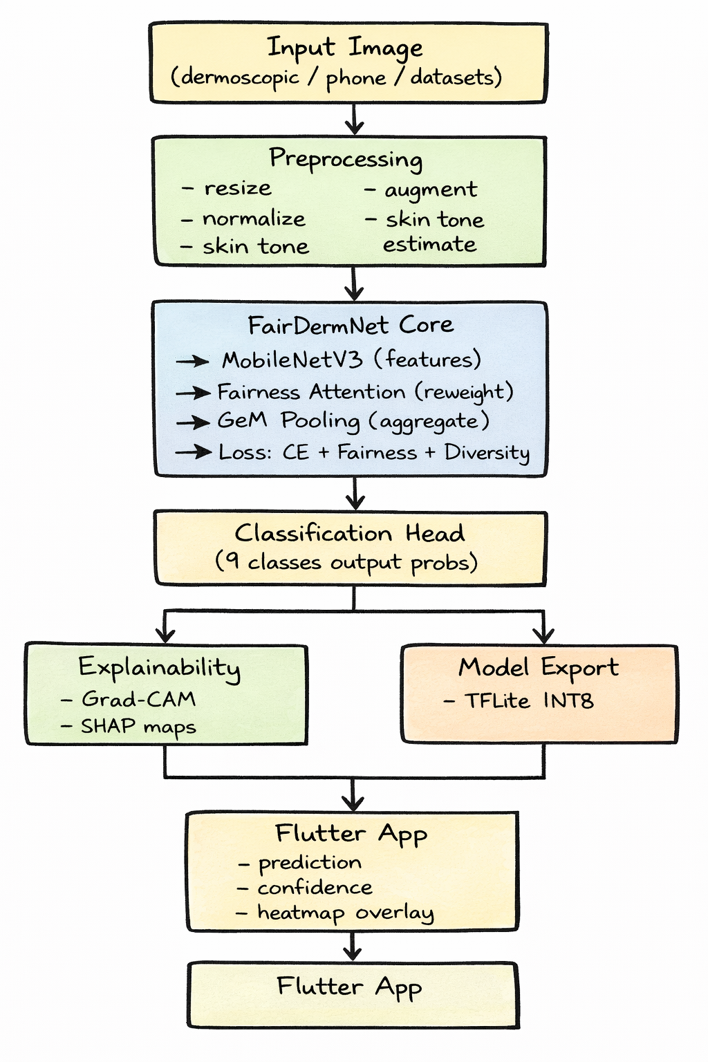
Methodology
Department of information Science and Engineering
www.cambridge.edu.in

Slide 15
System Design – Architecture Overview
Layer 1 - Input: Raw dermoscopic or smartphone image fed into the pipeline from any of the three datasets.
Layer 2 - Preprocessing: Resize, augmentation, normalisation, and Fitzpatrick skin-tone estimation before training.
Layer 3 - FairDermNet: The core backbone - MobileNetV3-Large extracts features → FAM reweights for skin-tone fairness → GeM pools richer descriptors → trained with composite fairness loss.
Layer 4 - Classification Head: Outputs probabilities across 9 lesion classes with per-class threshold calibration.
Layer 5 - Output Split:
Explainability branch → Grad-CAM + SHAP visual heatmaps
Export branch → TFLite INT8 quantised model
Layer 6 - Flutter App: Final deployment - on-device inference with class label, confidence score, and Grad-CAM overlay displayed to the user.
Department of information Science and Engineering
www.cambridge.edu.in

Slide 16
Phase 1 Recap
Problem Statement Existing skin cancer AI tools are biased against darker skin tones, lack explainability, and are inaccessible without specialist hardware.
Proposed Solution
FairDermNet (MobileNetV3 + FAM + GeM) trained with composite fairness loss across 9 lesion classes on ~37k multi-source images.
TFLite INT8 export deployed via Flutter app with Grad-CAM + SHAP explainability for on-device, accessible diagnosis.
Input image
Pre processing
FAIRDERMNET
9 class Prediction
GRAD-Cam +SHAP
Flutter App
Department of information Science and Engineering
www.cambridge.edu.in

Slide 17
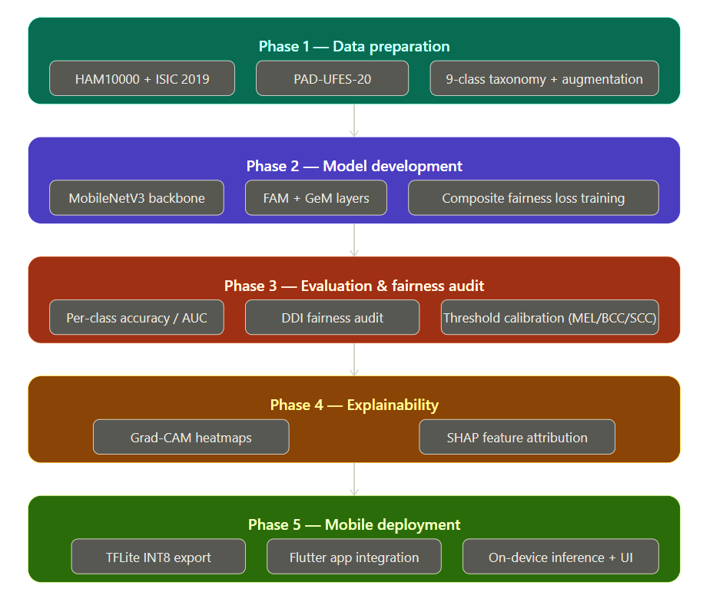
Implementation Overview
.
Department of information Science and Engineering
www.cambridge.edu.in

Slide 18
Web & Mobile Interfaces
Interface
A Flutter mobile application where the user captures or uploads a skin lesion image, triggering on-device TFLite inference that instantly displays the predicted lesion class, confidence score, and Grad-CAM heatmap overlay highlighting the diagnosed region.
A clean result screen presents the top predicted class with probability distribution across all 9 lesion types, a colour-coded risk indicator (malignant / benign), and a brief explainability summary - making the output interpretable for both patients and clinicians.
Department of information Science and Engineering
www.cambridge.edu.in

Slide 19
Testing Strategy
Unit Testing: Each module (preprocessing, FAM, GeM pooling, fairness loss, TFLite export) tested independently to validate correct input-output behaviour.
Model Testing: Evaluated on held-out test split (80-10-10) using per-class accuracy, AUC, precision, recall, and F1-score across all 9 lesion classes.
Fairness Testing. : DDI Stanford dataset (656 images) used exclusively to audit model performance across Fitzpatrick skin-tone groups 12 / 34 / 56, measuring equalized odds and demographic parity
Explainability Testing: Grad-CAM heatmaps visually verified by domain knowledge - highlighted regions must align with the actual lesion area, not background skin.
Mobile Testing: TFLite model tested on mid-range Android device for inference latency (target ≤500ms), memory usage, and output consistency against the PyTorch baseline.
Department of information Science and Engineering
www.cambridge.edu.in

Slide 20
Results & Observations
Department of information Science and Engineering
www.cambridge.edu.in

Slide 21
Security & Privacy Analysis
On-Device Inference: All processing happens locally via TFLite - no patient image is transmitted to any server, eliminating data interception risk entirely.
No Data Storage: The app does not store, log, or cache any captured skin images post-inference, ensuring zero persistent patient data on the device.
Model Security: The TFLite model is INT8 quantised and bundled within the app, preventing direct weight extraction or reverse engineering of training data.
Ethical Safeguard: The app displays a clear disclaimer that results are preliminary and not a substitute for professional clinical diagnosis, preventing misuse as a self-diagnosis tool.
Department of information Science and Engineering
www.cambridge.edu.in

Slide 22
Future Scope & Enhancements
Expanded Dataset: Incorporate larger and more diverse skin-tone datasets to further reduce Fitzpatrick IV–VI performance gaps.
Segmentation Module: Add lesion segmentation (U-Net based) alongside classification for more precise region delineation.
iOS Deployment: Extend Flutter app to iOS with CoreML model conversion for broader accessibility.
Continuous Learning: Implement federated learning to allow the model to improve from new clinical data without compromising patient privacy.
Dermatoscope Integration: Support clip-on smartphone dermatoscope attachments for higher image quality in clinical settings.
Department of information Science and Engineering
www.cambridge.edu.in

Slide 23
Conclusion & Future scope
DermaLens successfully addresses the three core gaps in existing AI dermatology tools - bias, opacity, and inaccessibility - by proposing a fairness-aware, explainable, and mobile-deployable skin cancer detection system. Built on FairDermNet (MobileNetV3 + FAM + GeM), trained on ~37,000 multi-source images with composite fairness loss, and deployed as a TFLite Flutter application, DermaLens delivers equitable 9-class lesion classification with Grad-CAM + SHAP explainability - making reliable preliminary skin cancer screening accessible to anyone, on any smartphone, regardless of skin tone.
Department of information Science and Engineering
www.cambridge.edu.in

Slide 24
.
Thank You
“We welcome your questions and feedback.”
Department of information Science and Engineering
www.cambridge.edu.in

